Slide 1
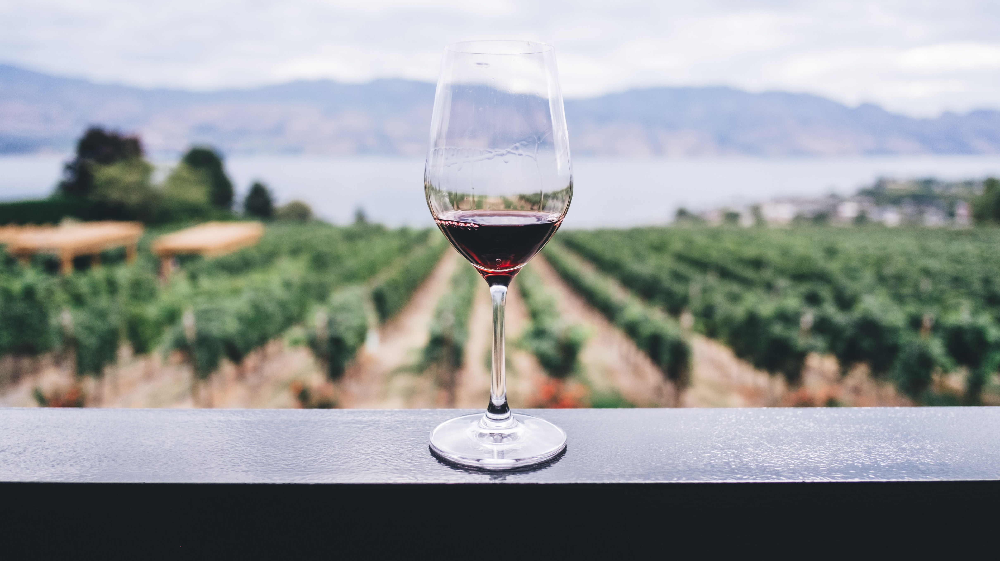
Do Expert Reviews Affect the Demand for Wine?
Richard Friberg and Erik Grönqvist
Presented by Erica Schultz

Slide 2
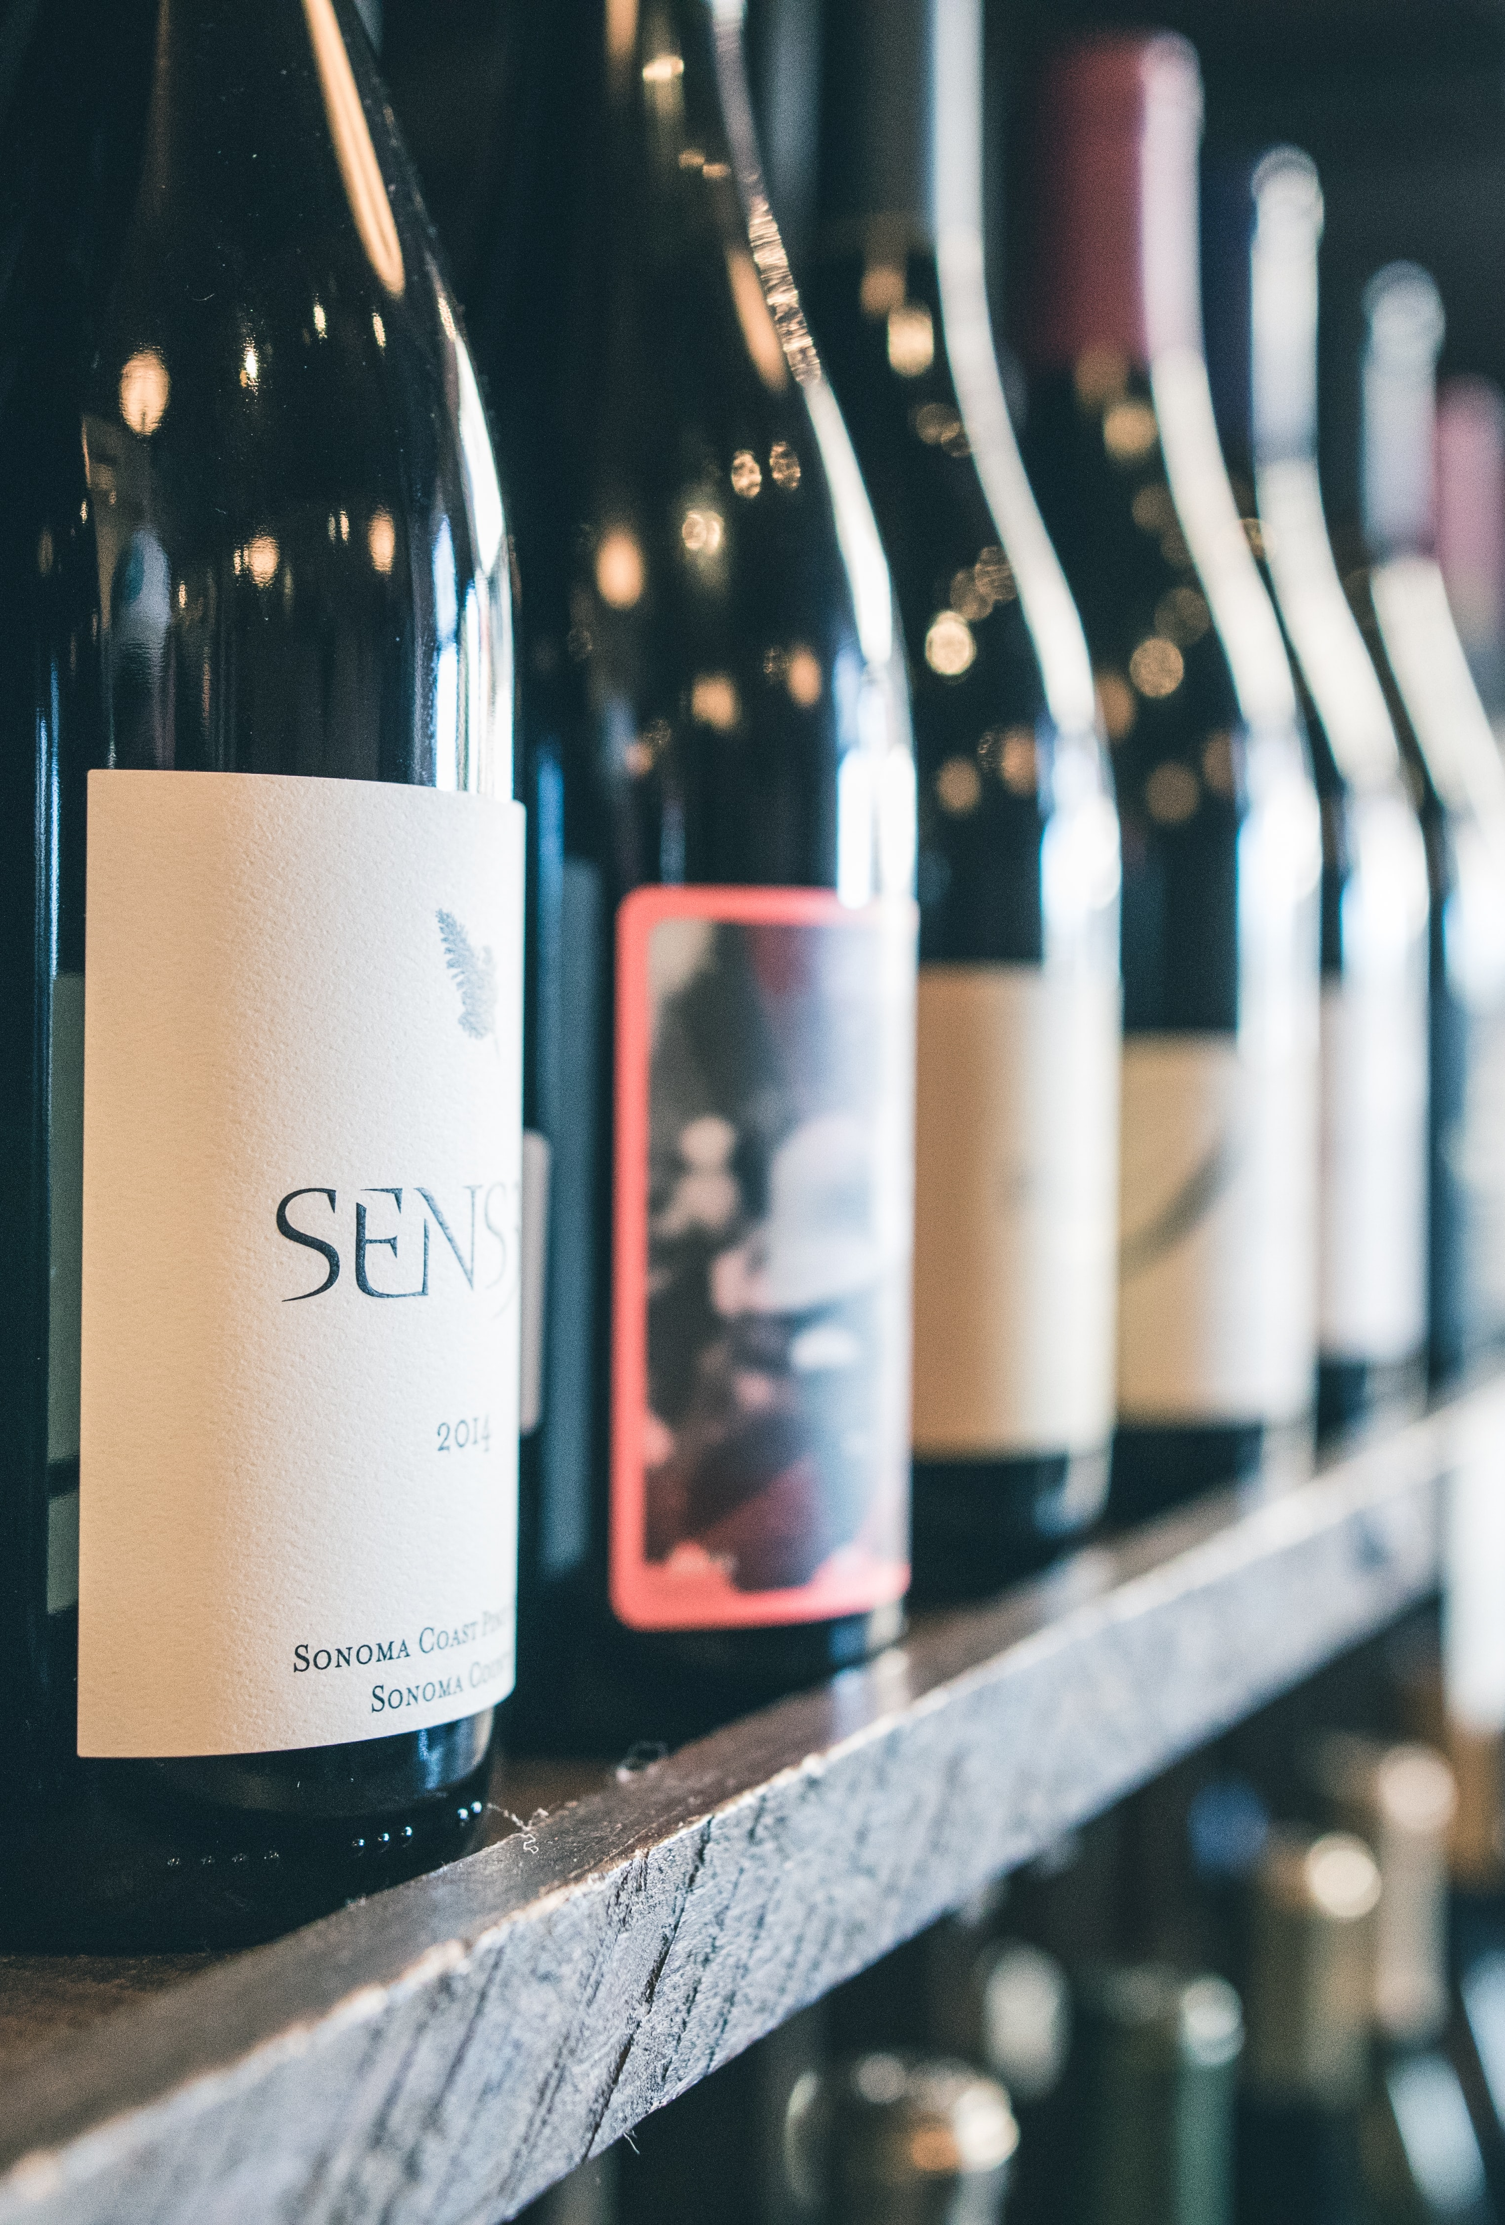
Motivation
Liquor stores are overwhelming
Brands signal quality
Signal from seller is biased
Signal from a wine expert?
Preview:
Reviews do increase demand!

Slide 3
Outline
Motivation
Data
Empirical Strategy
Results
Conclusions

Slide 4
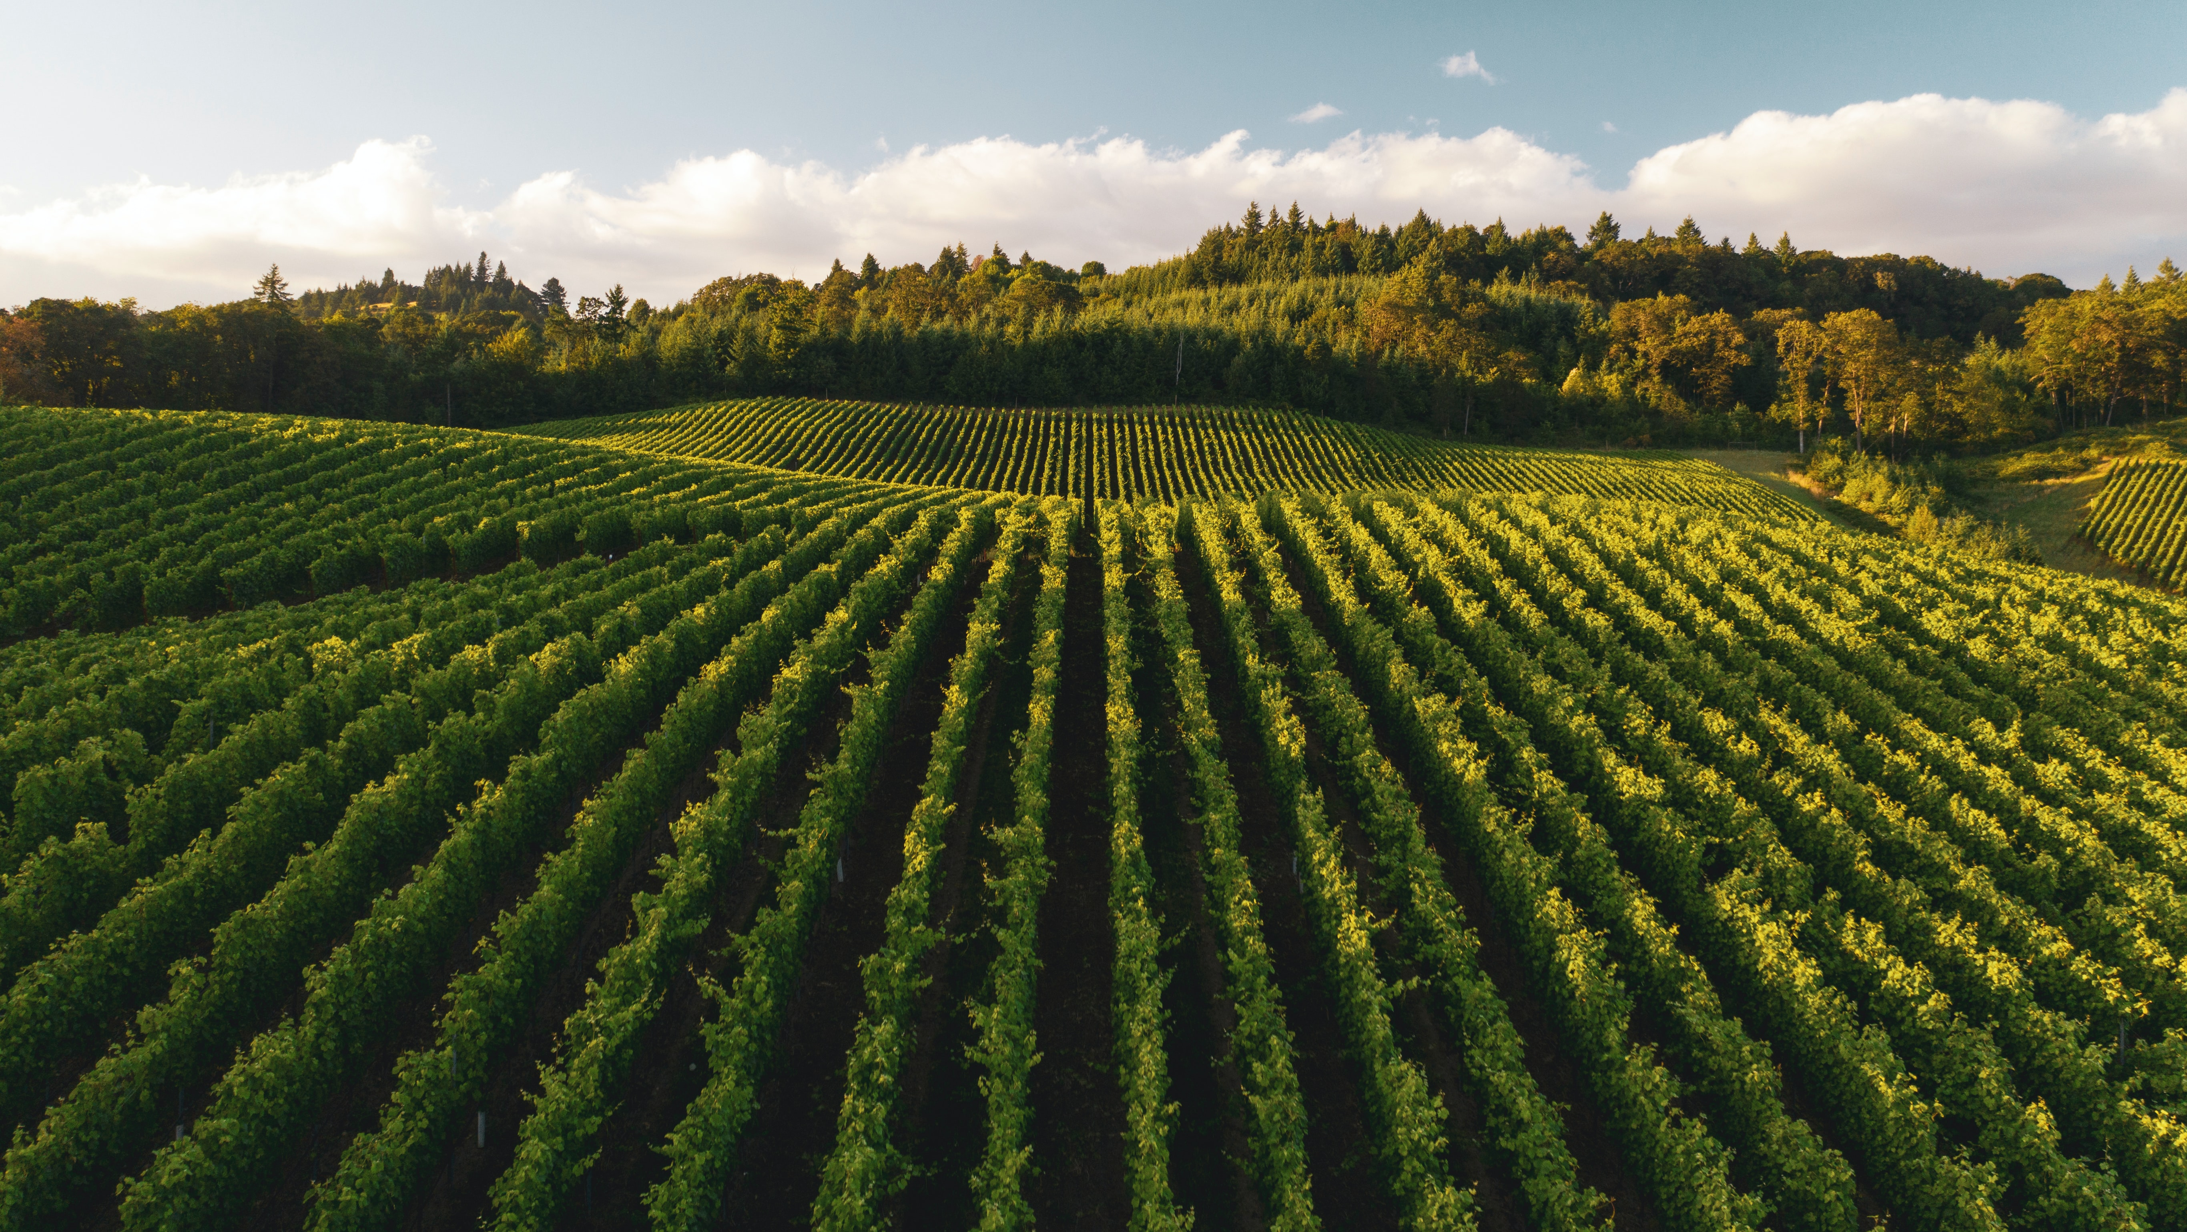
Data

Slide 5
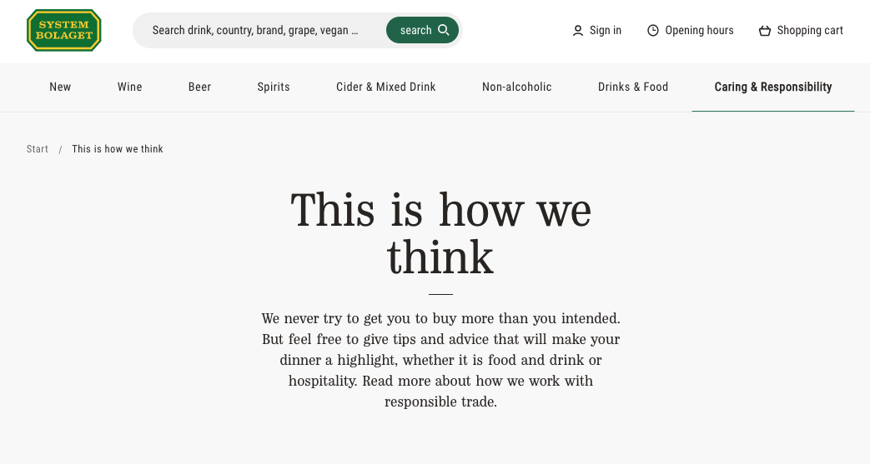
Notes:
Sweden has a state-owned monopoly retailer Systembolaget which is not a profit maximizer
They don’t do anything to try to increase sales
The government decides the markup applied to ALL wines, this changed only twice. The manufacturers are profit maximizing but since they sell to through Systembolaget, there is no adjusting prices for regional demand shocks

Slide 6
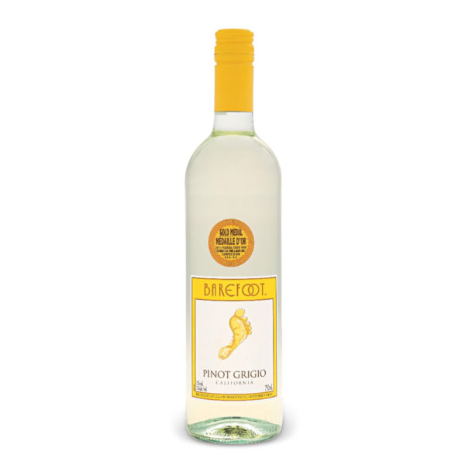
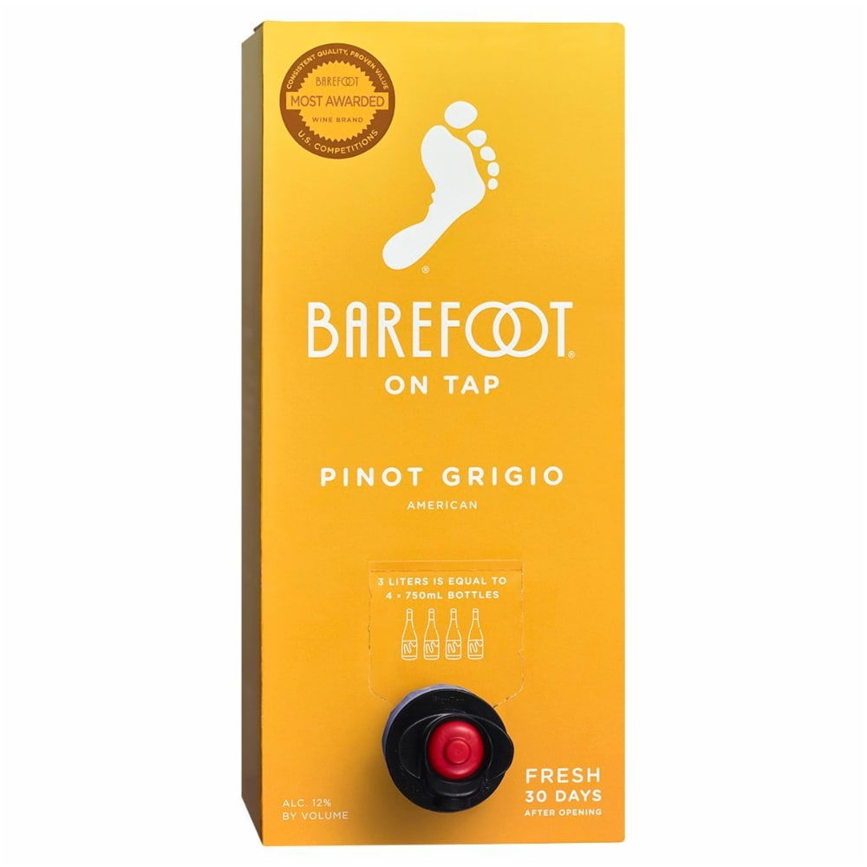
Data - Wine
Red, White, Sparking
750ml bottles or 3-liter bag-in-box
Sold in at least 77% of stores
One wine is specifically
Color, Size, Vintage, Reserve, etc.
Notes:
420 stores
Look at wines sold in atleast 325 stores

Slide 7
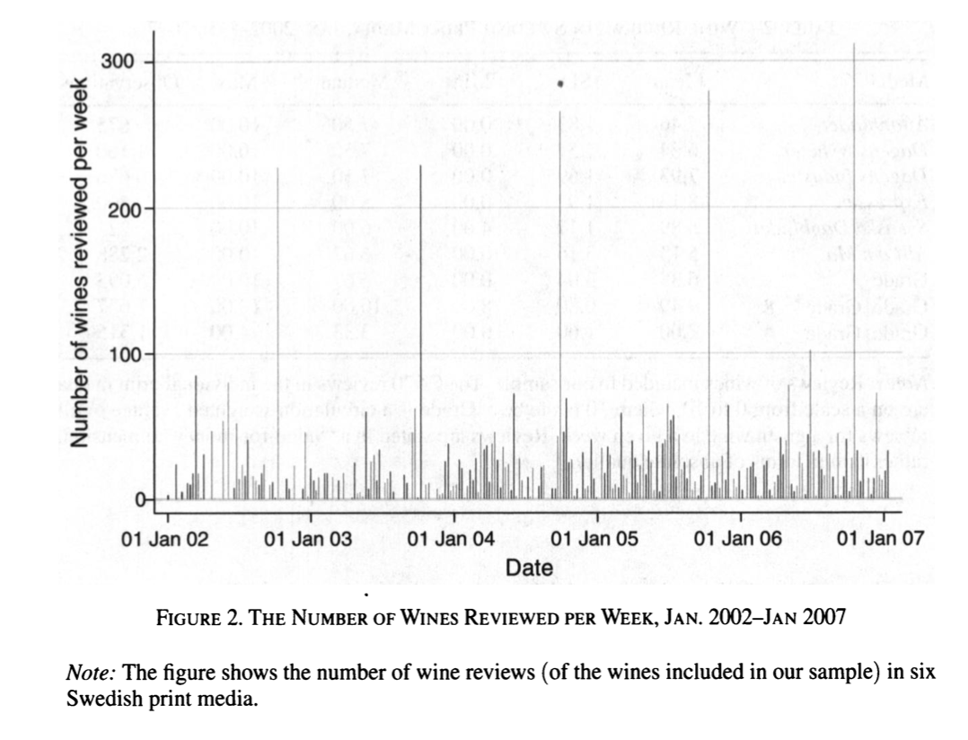
Data – Reviews
Six major Swedish print media
Targeted to general consumer
0-10 scale
Wine tasting issue of AoM in October
Notes:
If there are multiple reviews for a wine in one week, the grade is the circulation-weighted average of the reviews
Most of the time, a wine gets one review in a week
AoM – Allt om Mat

Slide 8

Empirical Strategy

Slide 9
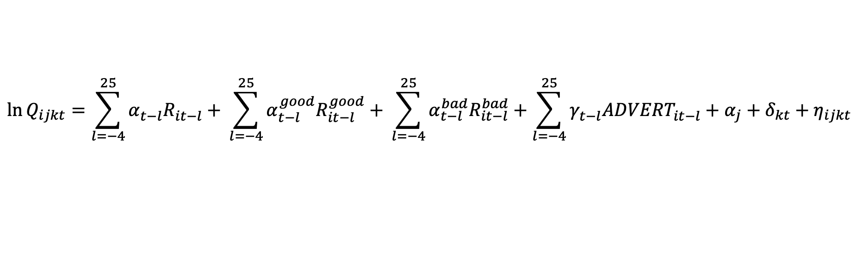
Empirical Strategy
$$\ln{Q_{ijkt}=\sum_{l=−4}^{25}{α_{t−l}^{}R_{it−l}^{}+ }\sum_{l=−4}^{25}{α_{t−l}^{good}R_{it−l}^{good}+ }}\sum_{l=−4}^{25}{α_{t−l}^{bad}R_{it−l}^{bad}+\sum_{l=−4}^{25}{γ_{t−l}^{}{ADVERT}_{it−l}^{}+α_{j}+δ_{kt}+η_{ijkt}}}$$
i = wine
j = vintage and price
k = segment (red, white, sparkling)
t = week

Slide 10
Empirical Strategy
$$\ln{Q_{ijkt}=\sum_{l=−4}^{25}{α_{t−l}^{}R_{it−l}^{}+ }\sum_{l=−4}^{25}{α_{t−l}^{good}R_{it−l}^{good}+ }}\sum_{l=−4}^{25}{α_{t−l}^{bad}R_{it−l}^{bad}+\sum_{l=−4}^{25}{γ_{t−l}^{}{ADVERT}_{it−l}^{}+α_{j}+δ_{kt}+η_{ijkt}}}$$
i = wine
j = vintage and price
k = segment (red, white, sparkling)
t = week

Slide 11
Empirical Strategy
$$\ln{Q_{ijkt}=\sum_{l=−4}^{25}{α_{t−l}^{}R_{it−l}^{}+ }\sum_{l=−4}^{25}{α_{t−l}^{good}R_{it−l}^{good}+ }}\sum_{l=−4}^{25}{α_{t−l}^{bad}R_{it−l}^{bad}+\sum_{l=−4}^{25}{γ_{t−l}^{}{ADVERT}_{it−l}^{}+α_{j}+δ_{kt}+η_{ijkt}}}$$
i = wine
j = vintage and price
k = segment (red, white, sparkling)
t = week
Notes:
25 week lag is to adress the timing of the effect of a review
4 week lead is to address the possibility that a review might be triggered by a random demand shock, if this is true then we should see signif positive coef’s on the leads.

Slide 12
Empirical Strategy
$$\ln{Q_{ijkt}=\sum_{l=−4}^{25}{α_{t−l}^{}R_{it−l}^{}+ }\sum_{l=−4}^{25}{α_{t−l}^{good}R_{it−l}^{good}+ }}\sum_{l=−4}^{25}{α_{t−l}^{bad}R_{it−l}^{bad}+\sum_{l=−4}^{25}{γ_{t−l}^{}{ADVERT}_{it−l}^{}+α_{j}+δ_{kt}+η_{ijkt}}}$$
i = wine
j = vintage and price
k = segment (red, white, sparkling)
t = week

Slide 13
Empirical Strategy
$$\ln{Q_{ijkt}=\sum_{l=−4}^{25}{α_{t−l}^{}R_{it−l}^{}+ }\sum_{l=−4}^{25}{α_{t−l}^{good}R_{it−l}^{good}+ }}\sum_{l=−4}^{25}{α_{t−l}^{bad}R_{it−l}^{bad}+\sum_{l=−4}^{25}{γ_{t−l}^{}{ADVERT}_{it−l}^{}+α_{j}+δ_{kt}+η_{ijkt}}}$$
i = wine
j = vintage and price
k = segment (red, white, sparkling)
t = week

Slide 14
Empirical Strategy
$$\ln{Q_{ijkt}=\sum_{l=−4}^{25}{α_{t−l}^{}R_{it−l}^{}+ }\sum_{l=−4}^{25}{α_{t−l}^{good}R_{it−l}^{good}+ }}\sum_{l=−4}^{25}{α_{t−l}^{bad}R_{it−l}^{bad}+\sum_{l=−4}^{25}{γ_{t−l}^{}{ADVERT}_{it−l}^{}+α_{j}+δ_{kt}+η_{ijkt}}}$$
i = wine
j = vintage and price
k = segment (red, white, sparkling)
t = week
Notes:
*Advertising is a choice by the importer/manufacturer
* Sweden has strict rules about advertising and so advertising is really informative rather than persuasive

Slide 15
Empirical Strategy
$$\ln{Q_{ijkt}=\sum_{l=−4}^{25}{α_{t−l}^{}R_{it−l}^{}+ }\sum_{l=−4}^{25}{α_{t−l}^{good}R_{it−l}^{good}+ }}\sum_{l=−4}^{25}{α_{t−l}^{bad}R_{it−l}^{bad}+\sum_{l=−4}^{25}{γ_{t−l}^{}{ADVERT}_{it−l}^{}+α_{j}+δ_{kt}+η_{ijkt}}}$$
i = wine
j = vintage and price
k = segment (red, white, sparkling)
t = week
Notes:
Wine X vintage X price FE
This allows us to differentiate between different prices or different vintages of a particular wine

Slide 16
Empirical Strategy
$$\ln{Q_{ijkt}=\sum_{l=−4}^{25}{α_{t−l}^{}R_{it−l}^{}+ }\sum_{l=−4}^{25}{α_{t−l}^{good}R_{it−l}^{good}+ }}\sum_{l=−4}^{25}{α_{t−l}^{bad}R_{it−l}^{bad}+\sum_{l=−4}^{25}{γ_{t−l}^{}{ADVERT}_{it−l}^{}+α_{j}+δ_{kt}+η_{ijkt}}}$$
i = wine
j = vintage and price
k = segment (red, white, sparkling)
t = week
Notes:
Week X segment FE
Controls for time trends in sales

Slide 17
Empirical Strategy
$$\ln{Q_{ijkt}=\sum_{l=−4}^{25}{α_{t−l}^{}R_{it−l}^{}+ }\sum_{l=−4}^{25}{α_{t−l}^{good}R_{it−l}^{good}+ }}\sum_{l=−4}^{25}{α_{t−l}^{bad}R_{it−l}^{bad}+\sum_{l=−4}^{25}{γ_{t−l}^{}{ADVERT}_{it−l}^{}+α_{j}+δ_{kt}+η_{ijkt}}}$$
i = wine
j = vintage and price
k = segment (red, white, sparkling)
t = week
Notes:
Clustered SE’s at brand level

Slide 18
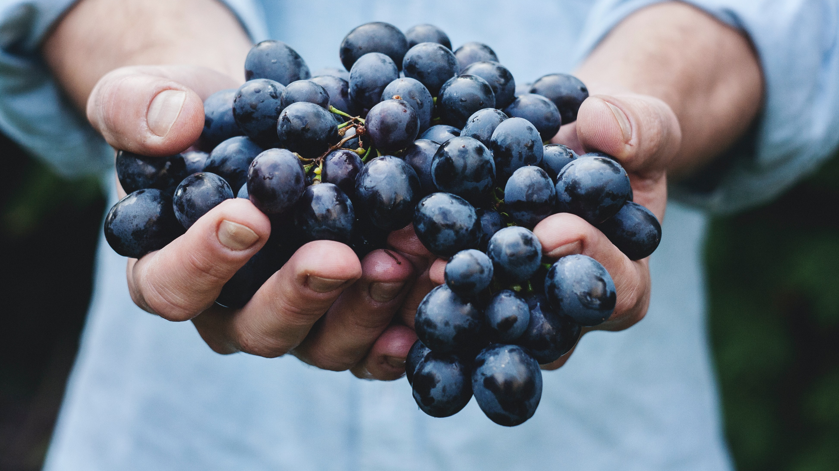
Results

Slide 19
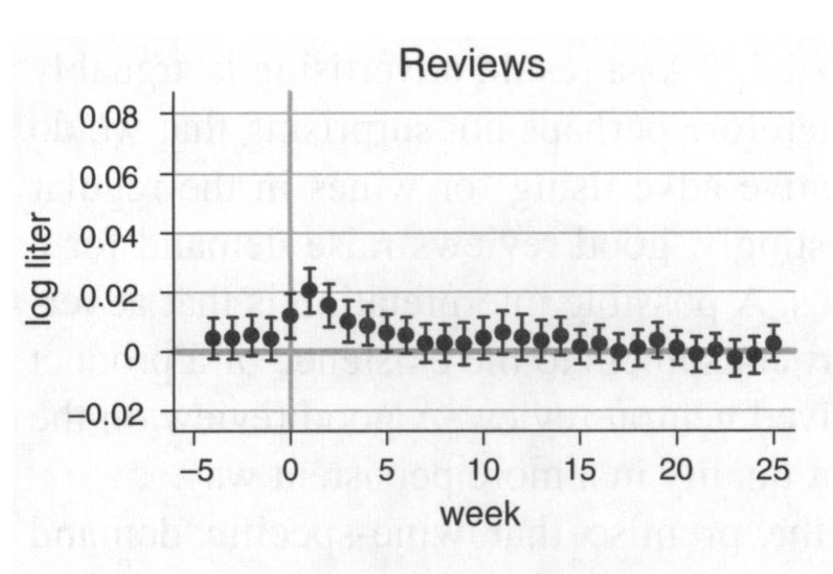
Results
Notes:
In the same week: increased sales by 1.2%
One week later: increased sales by 2%
Effect lasts up to 5 weeks

Slide 20
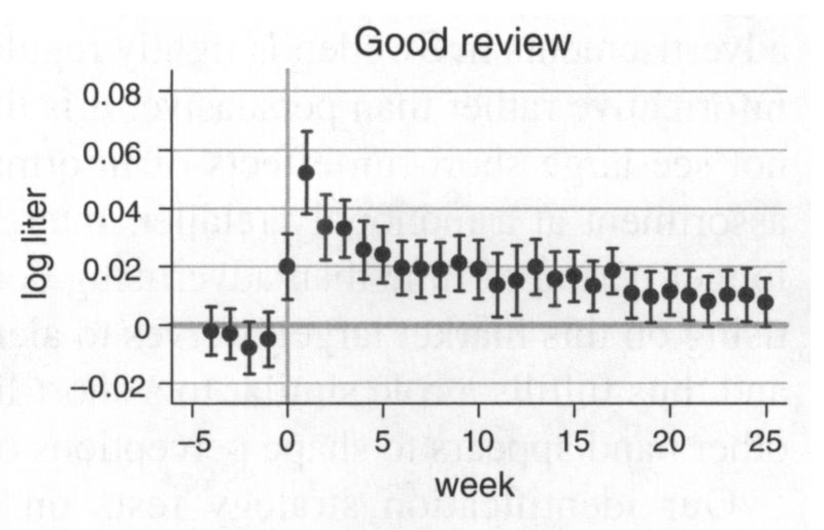
Results
Notes:
Week of good review: increase additional 2%
One week later: increase 5.2%
Effect remains up to 22 weeks

Slide 21
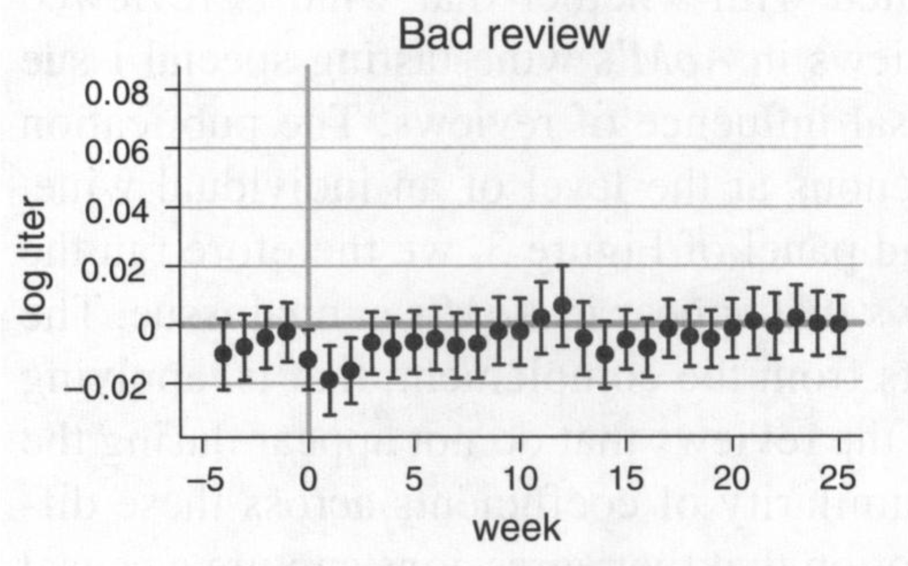
Results
Notes:
Significant decrease
BUT this is nullified by the positive effect of getting a review at all

Slide 22
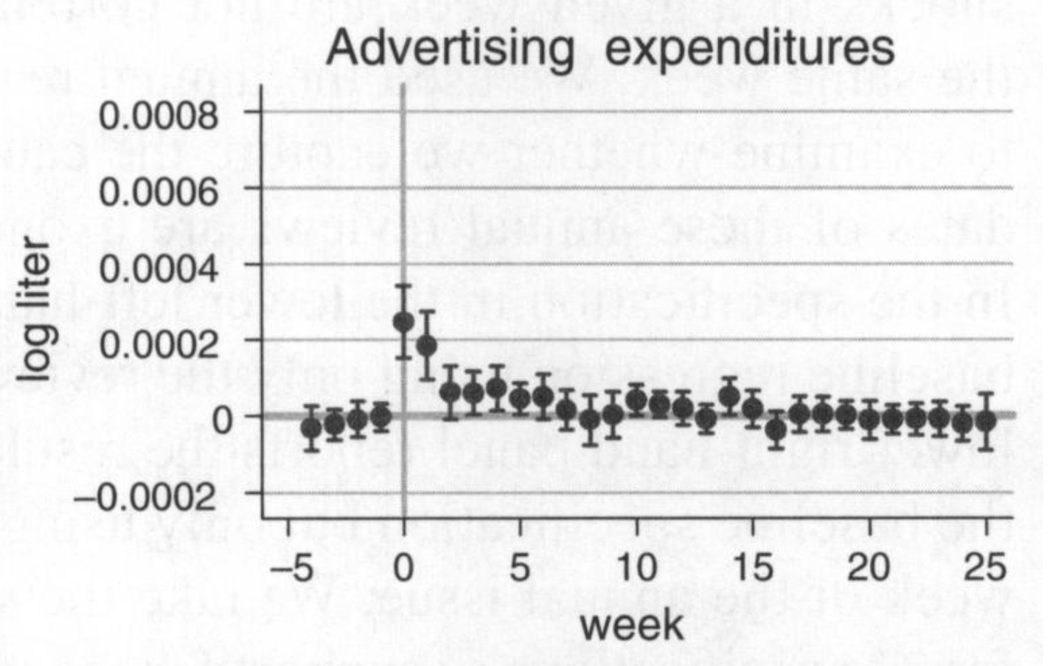
Results
Notes:
Advertising has significant but small effect
Every 1000 Swedish kronas increases sales by .025% (about $136 at the time)

Slide 23
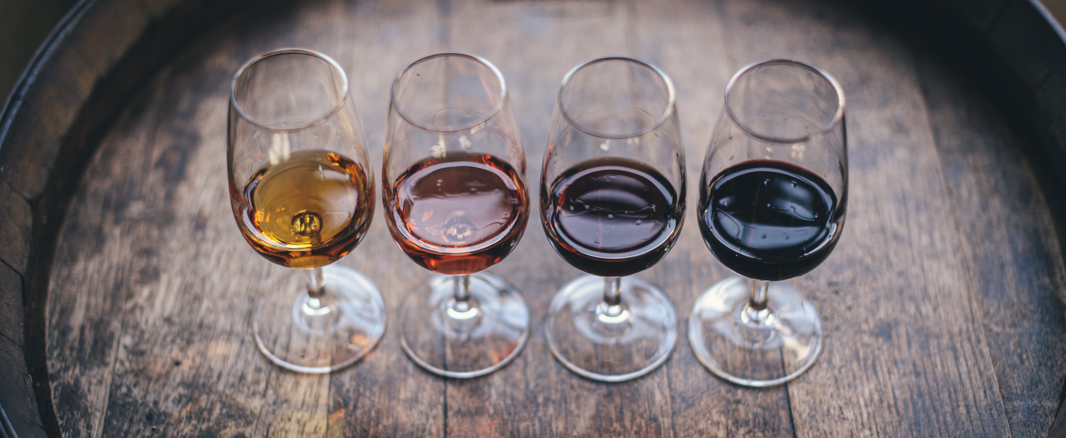
What else might influence demand?

Slide 24
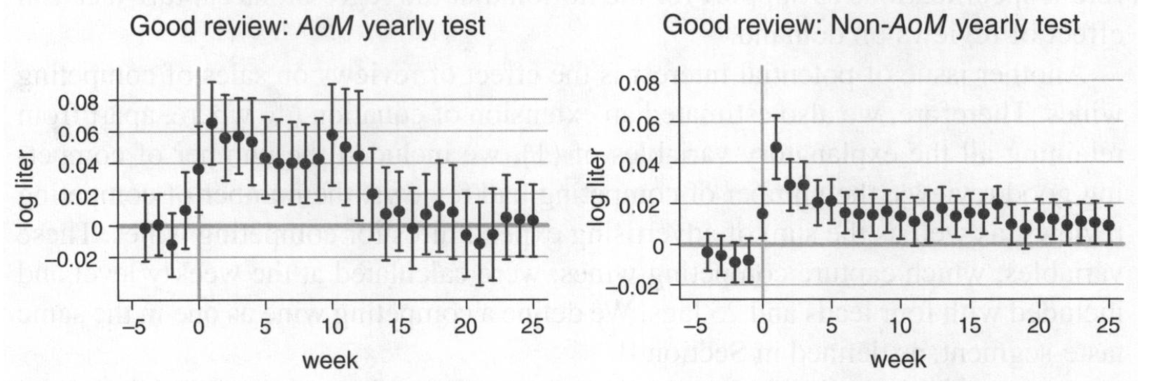
Results
Notes:
Advertising has significant but small effect
Every 1000 Swedish kronas increases sales by .025% (about $136 at the time)

Slide 25
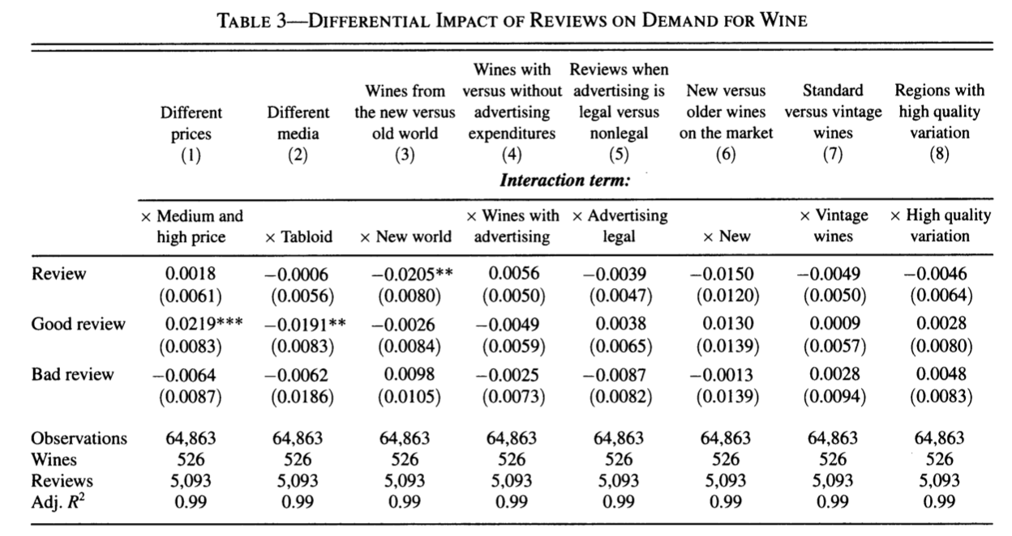
Interaction Effects
Notes:
Expensive wine: reviews are probably more important to consumers buying more expensive wines
Tabloid: the effect of a good review is diminished by the review being in a tabloid
New World: the effect of a review is diminished by the wine being no—European (this is probably because non-European wines are more wellknown by their brand and so the informative nature of the review is nullified)

Slide 26
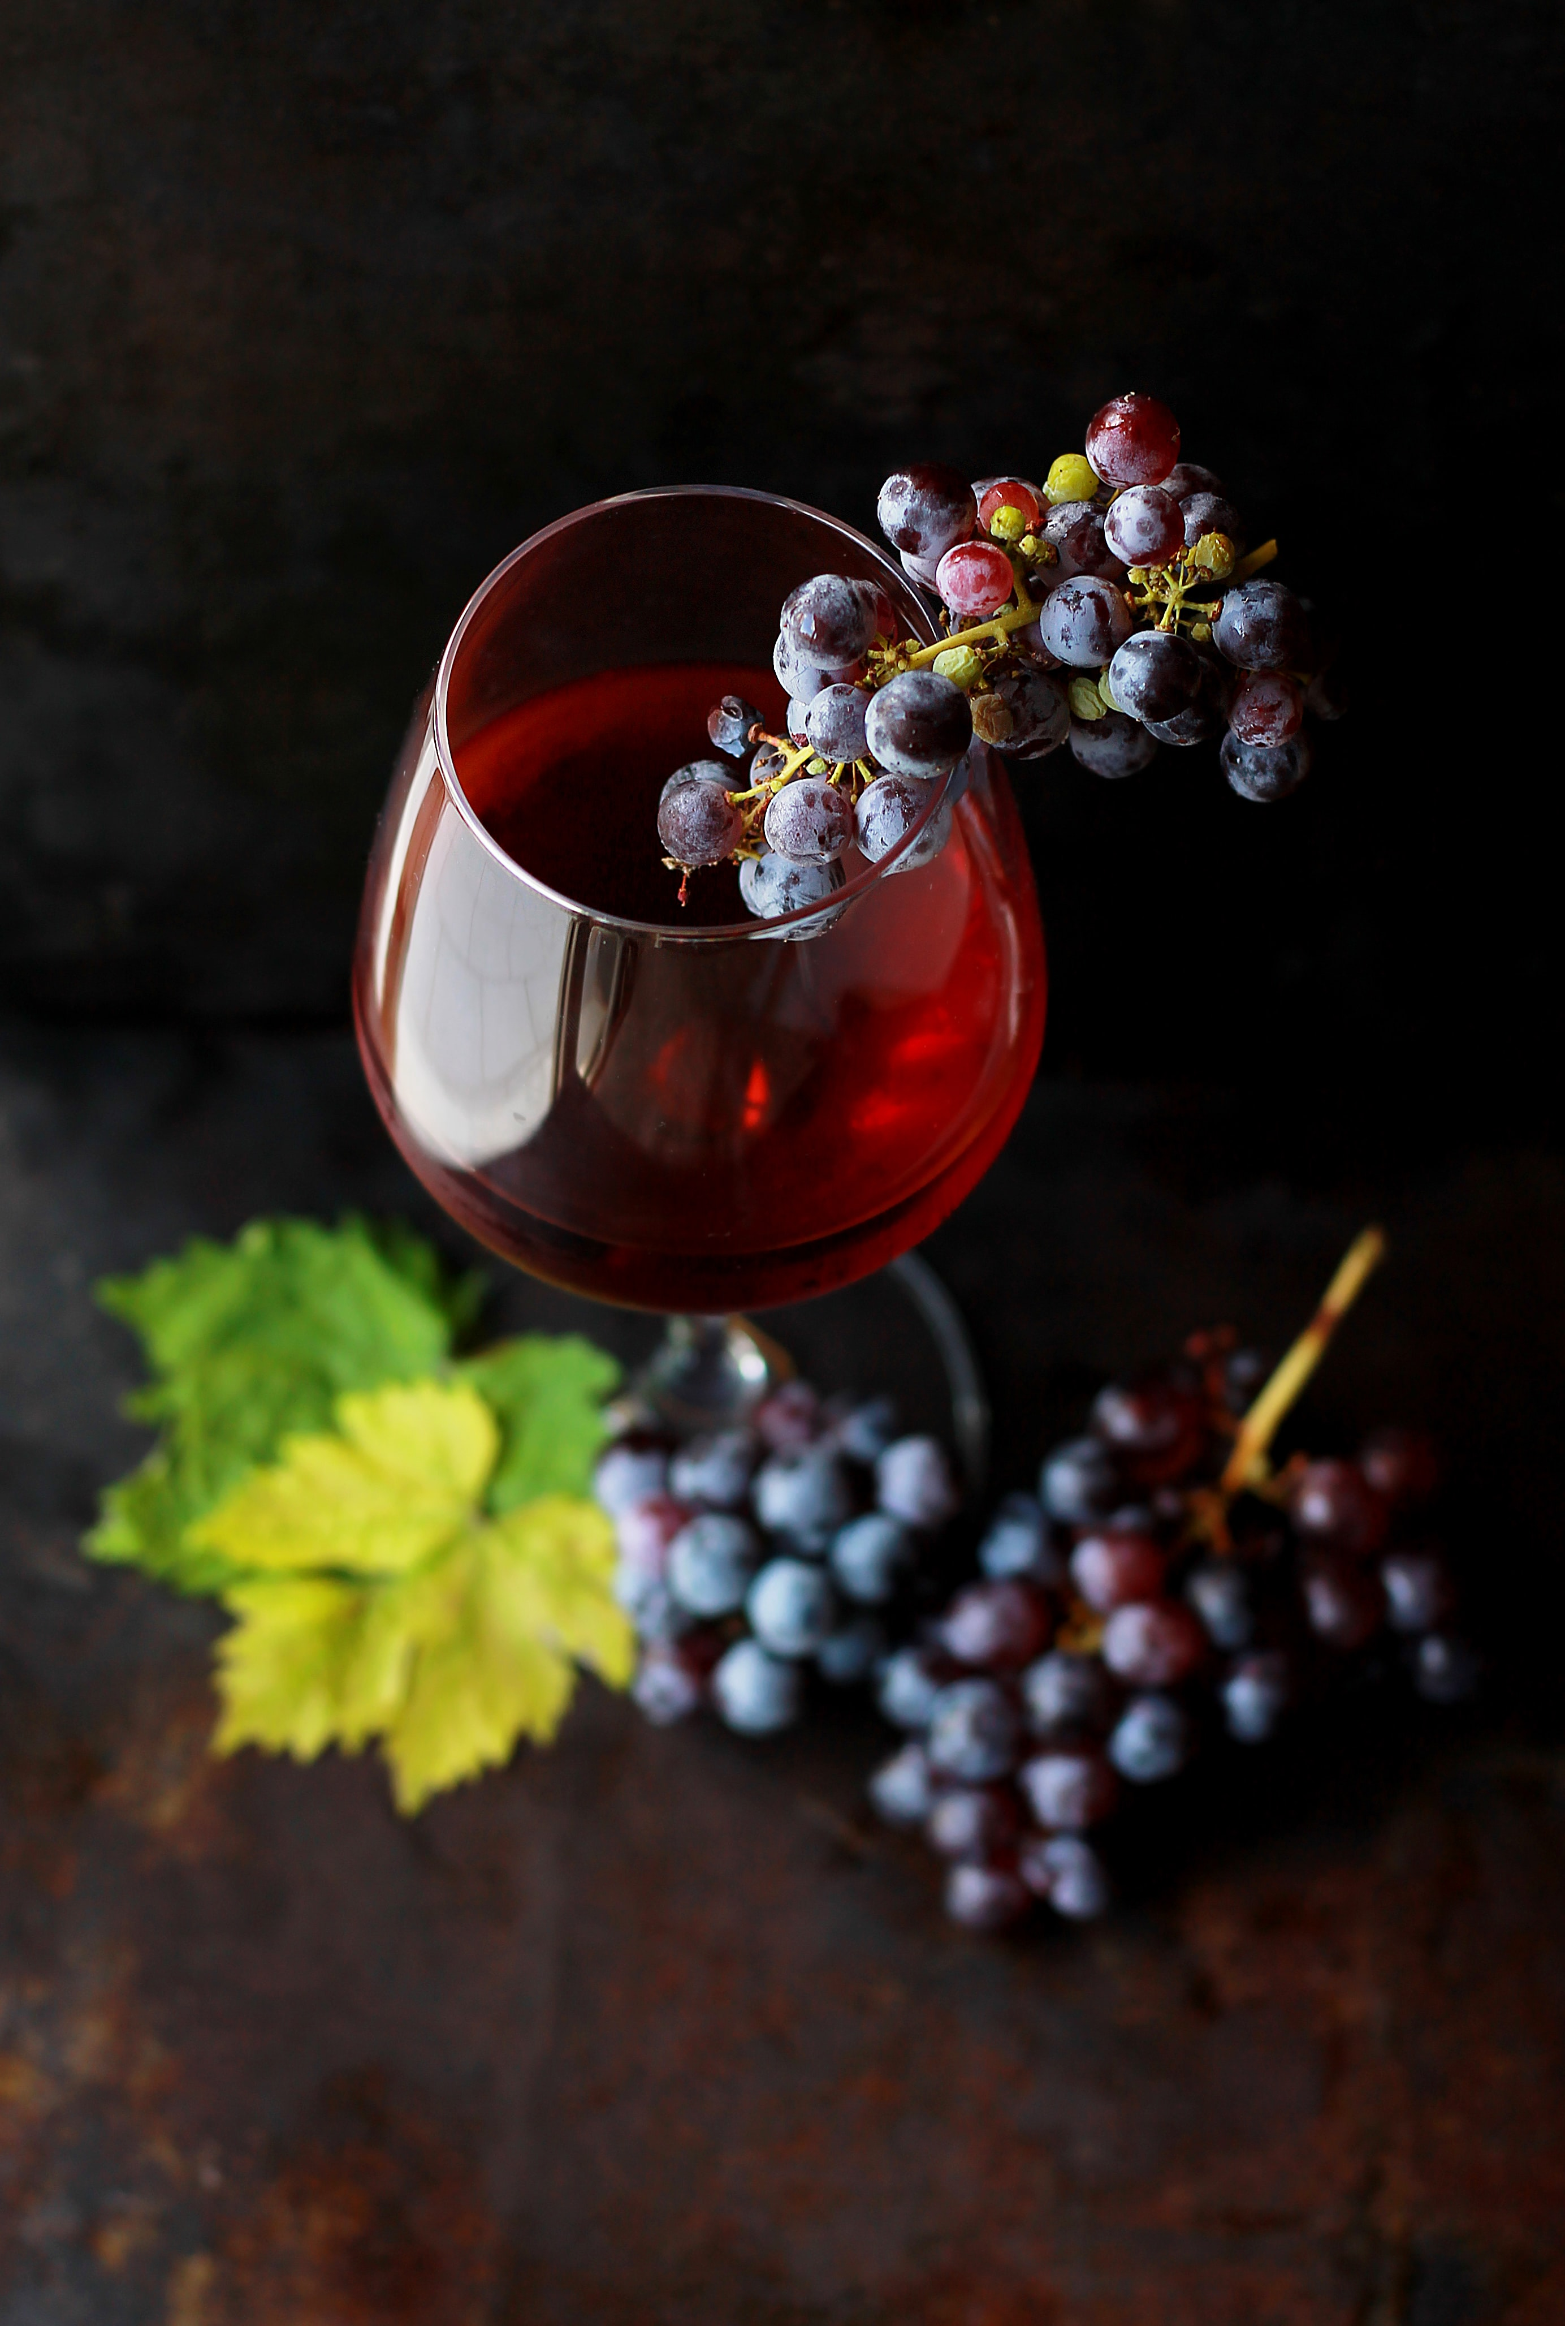
Conclusions
Reviews increase demand!
Good reviews better
Bad reviews cancelled out
Advertising = Neutral Review
Signal to existence, not quality
Even better results for
Expensive wine
Not in tabloid

Slide 27
Caveats and Further Research
Validity in other countries
Heterogeneous effects – need consumer level data

Slide 28

Questions?

Slide 29
Citations for Pictures
https://www.google.com/url?sa=i&url=https%3A%2F%2Fwww.pinterest.fr%2Fpin%2F547117054708244296%2F&psig=AOvVaw0Ov01mptD8gHBvwbJx1Qqk&ust=1603902154797000&source=images&cd=vfe&ved=0CAIQjRxqFwoTCNiIyamX1ewCFQAAAAAdAAAAABAD
https://www.google.com/url?sa=i&url=http%3A%2F%2Falmazagrocerybz.com%2Fproduct%2Fbarefoot-pinot-grigio-wine-750ml%2F&psig=AOvVaw1ji1090-ahUtc9poRs2tUk&ust=1604369887823000&source=images&cd=vfe&ved=0CAIQjRxqFwoTCIDmkd_l4uwCFQAAAAAdAAAAABAD
https://www.google.com/url?sa=i&url=https%3A%2F%2Fwww.kroger.com%2Fp%2Fbarefoot-on-tap-pinot-grigio-white-wine-box%2F0008500002295&psig=AOvVaw0RdlfbfGrGmteApOwtqMOE&ust=1604369932650000&source=images&cd=vfe&ved=0CAIQjRxqFwoTCOipwvLl4uwCFQAAAAAdAAAAABAD

